Slide 1

Université de Mostaganem — Dr. Madani BELACEL
TIC COURSE 07
The Internet: Principles and Usage
Dr. BELACEL Madani
Année universitaire 2026-2027 / Academic Year 2026-2027
Université de Mostaganem - Département Mathématiques et Informatique

Slide 2
Université de Mostaganem — Dr. Madani BELACEL
Course Outline
▪ 1. What Is the Internet?
▪ 2. History of the Internet
▪ 3. Connecting to the Internet
▪ 4. Web Browsers
▪ 5. Electronic Mail
▪ 6. Searching for Information
▪ 7. Internet Security

Slide 3
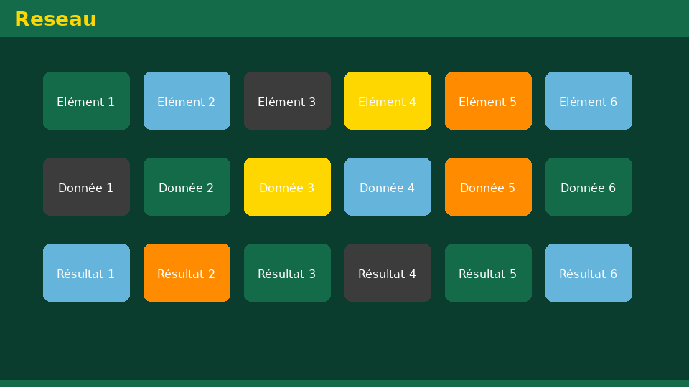
Université de Mostaganem — Dr. Madani BELACEL
Section 1
What Is the Internet?

Slide 4
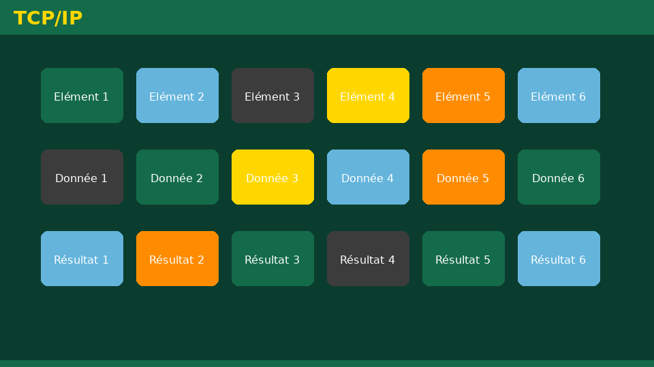
Université de Mostaganem — Dr. Madani BELACEL
1 - What Is the Internet?
▪ A worldwide network connecting millions of networks.
▪ Physical infrastructure: cables, fiber, satellites, routers.
▪ Built on the TCP/IP protocol family.
▪ Services: Web, email, messaging, streaming, cloud.

Slide 5

Université de Mostaganem — Dr. Madani BELACEL
Section 2
History of the Internet

Slide 6

Université de Mostaganem — Dr. Madani BELACEL
2 - History of the Internet
▪ 1969: ARPANET, an American military project.
▪ 1983: TCP/IP adoption, the technical birth of the Internet.
▪ 1991: opening to the general public and commerce.
▪ Today: over 5 billion users worldwide.

Slide 7

Université de Mostaganem — Dr. Madani BELACEL
Section 3
Connecting to the Internet

Slide 8

Université de Mostaganem — Dr. Madani BELACEL
3 - Connecting to the Internet
▪ Internet Service Provider (ISP): telecom operator.
▪ Connection types: ADSL, fiber optics, 4G/5G, satellite.
▪ Equipment: modem, router, Wi-Fi box.
▪ IP address: unique identifier of every machine.
▪ DNS: directory translating domain names into IPs.

Slide 9

Université de Mostaganem — Dr. Madani BELACEL
Section 4
Web Browsers

Slide 10

Université de Mostaganem — Dr. Madani BELACEL
4 - Web Browsers
▪ Software to access websites: Chrome, Firefox, Edge, Safari.
▪ Address bar: URL of the visited site.
▪ Tabs, bookmarks and history.
▪ Downloads and settings (language, security).

Slide 11

Université de Mostaganem — Dr. Madani BELACEL
Section 5
Electronic Mail

Slide 12

Université de Mostaganem — Dr. Madani BELACEL
5 - Electronic Mail
▪ Email address: user@domain (e.g., name@univ-bechar.dz).
▪ Composition: recipient, subject, body, attachments.
▪ Protocols: SMTP (sending), POP3/IMAP (receiving).
▪ Webmail vs desktop clients (Outlook, Thunderbird).
▪ Netiquette: politeness, clear subject, Bcc for groups.

Slide 13

Université de Mostaganem — Dr. Madani BELACEL
Section 6
Searching for Information

Slide 14

Université de Mostaganem — Dr. Madani BELACEL
6 - Searching for Information
▪ Search engines: Google, Bing, Qwant.
▪ Effective keywords: quotes, minus sign, site:
▪ Assess reliability: source, date, author.
▪ Academic databases: Google Scholar, ScienceDirect.

Slide 15
Université de Mostaganem — Dr. Madani BELACEL
Section 7
Internet Security

Slide 16
Université de Mostaganem — Dr. Madani BELACEL
7 - Internet Security
▪ Strong passwords and password managers.
▪ Phishing: spotting fake emails and suspicious links.
▪ HTTPS: encrypted connection (padlock in the bar).
▪ Antivirus, firewall and updates.
▪ Protecting personal data.

Slide 17
Université de Mostaganem — Dr. Madani BELACEL
Practical Interest
▪ Communicate freely anywhere in the world.
▪ Access a global library of knowledge.
▪ Handle administrative tasks and online shopping.
▪ Work remotely: video conferencing, collaborative cloud.

Slide 18
Université de Mostaganem — Dr. Madani BELACEL
Self-Assessment (MCQ)
1. Which protocol is the foundation of the Internet?
a) HTTP only
b) TCP/IP
c) USB
2. What does DNS do?
a) It encrypts data
b) It translates domain names into IP addresses
c) It stores emails
3. A secure website starts with:
a) http://
b) https://
c) ftp://

Slide 19
Université de Mostaganem — Dr. Madani BELACEL
Conclusion
▪ The Internet connects people and machines worldwide.
▪ TCP/IP, ISPs, DNS and browsers are its essential building blocks.
▪ Vigilance is essential: security and data protection.
▪ Next course: the World Wide Web in detail.

Slide 20
Université de Mostaganem — Dr. Madani BELACEL
References
- O. Martinot, "Understanding the Internet", Ellipses.
- CNIL - practical privacy guides online.
- ICT Course materials, University of Mostaganem.
- www.internetlivestats.com

Slide 21
Université de Mostaganem — Dr. Madani BELACEL
Thank you for your attention!
Questions?
Dr. BELACEL Madani

